Slide 1

PRESCRIBING GROWTH: A DATA-DRIVEN BLUEPRINT FOR COLUMBIA ASIA'S FUTURE
-By Mohammed Hussain Mansuri

Slide 2

ABOUT COLUMBIA ASIA
Columbia Asia is a multinational chain of hospitals and one of the largest and fastest-growing healthcare companies in Southeast Asia. Columbia Asia started its operations in 1996, with the first hospital acquired a year later in Sarawak, East Malaysia. Currently, it has 22 medical facilities across Southeast Asia: 14 in Malaysia, 3 in Vietnam, and 5 in Indonesia.
Columbia Asia medical facilities provide comprehensive medical services such as General Surgery, Cardiology, Neurology, Pediatrics, Obstetrics and Gynecology, Orthopedics and Trauma, Oncology and Internal Medicine. These are supported by ancillary services that include an Intensive Care Unit(ICU), Neonatal Care Unit, Physiotherapy, Laboratory, Pharmacy, and Imaging.

Slide 3


ANALYSIS OBJECTIVE
Assess the hospital's revenue generation.
Departments which are more profitable and the departments which the hospital should focus on.
Insights about suitable departments for new hires, by analyzing patient visit count and the current number of doctors working right now.
Strategies and suggestions for patient discounts, which could further benefit us in increasing our customer base.
Analyze our patient demographics with respect to race, age group and gender.

Slide 4

DATA DICTIONARY
Date: This column contains date and time information without specifying AM or PM. The format is DD-MM-YYYY HH:MM.
Patient ID: Each patient is assigned a unique identifier, which seems to be in the format 124-62-3289.
Patient Gender: This column records the gender of the patient, denoted by 'M' for male and 'F' for female.
Patient Age: The age of the patients is listed in years.
Patient Sat Score: It seems to represent a satisfaction score given by or for the patient. However, the scores are single-digit, and it's not clear what the scale is.
Patient First Initial: This column contains the first initial of the patient's first name.
Patient Last Name: The surname of the patient is listed in this column.

Slide 5

Patient Race: The racial or ethnic background of the patient is recorded here, with categories such as 'White', 'African American', 'Asian', 'Native American/Alaska Native', and 'Two or More Races'.
Patient Admin Flag: This column contains Boolean values ('TRUE' or 'FALSE') which might indicate whether the patient was admitted or some other administrative flag.
Patient Wait Time: Appears to indicate the time the patient waited, possibly in minutes, before being seen or processed.
Department Referral: This column lists the department to which the patient was referred, with entries such as 'General Practice', 'Orthopedics', 'Gastroenterology', or 'None' indicating no referral.
Doctor Name: Identifies the doctor who attended each patient.
Appointment Fees: The cost charged for a doctor's consultation.
Total Bill: The overall amount billed to the patient, including all services and charges.

Slide 6

METHODOLOGY
Data Cleaning: Used Power Query to transform columns and replace null values with meaningful data.
Measures: Created various calculated measures using DAX queries to get desired output.
Calculated Columns: Used Power Query transformation to add additional columns for data calculations to reach desired objectives.
Data Visualization: Used Power BI canvas to create interactive reports containing 3 different tabs.

Slide 7
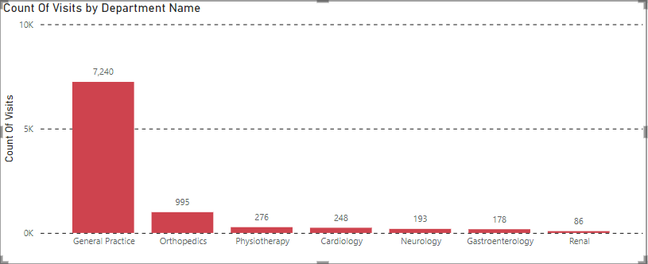
COUNT OF VISITS PER DEPARTMENT
From the above chart, we can figure out that General Practice gets the most visits with around 7,240 visits.
Followed by Orthopedics, Physiotherapy and Cardiology with 995, 276 and 248 visits.
The lowest visited department in our hospital is Renal with 86 visits after Gastroenterology and Neurology with 178 and 193 visits respectively.

Slide 8
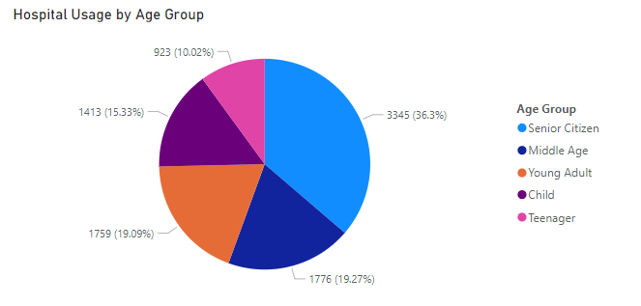
HOSPITAL UTILIZATION BY AGE GROUP
We can observe in the above pie diagram that Senior Citizens utilize this hospital the most with around 3,345 patients or 36.3% of the total patient in the hospital.
This is followed closely by Middle Age and Young Adult group with 1,776 people or 19.27% and 1,759 or 19.09% of peoples.
The least usage is done by teenagers with only 923 teenage patients which is 10.02% and then Children with 1413 total children or 15.33%.

Slide 9
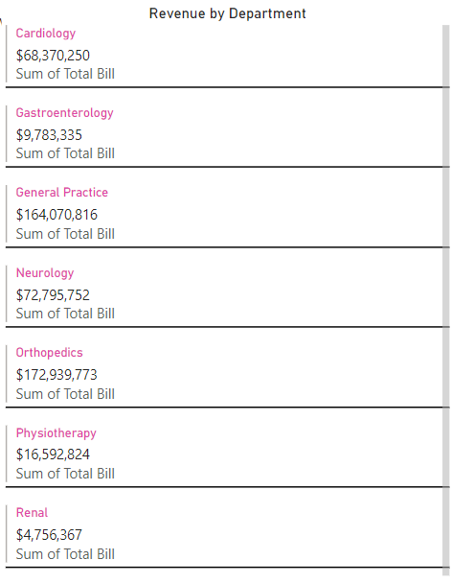
REVENUE GENERATION BY EACH DEPARTMENT
As we can observe from the multi-row cards visual, the contribution of different departments in hospital’s revenue.
We can see that Cardiology nets us revenue with a sum of $68,370,250.
Gastroenterology and General Practice comes in at with $9,783,335 and $164,070,816 respectively.
Renal and Physiotherapy has generated $4,756,367 and $16,592,824 respectively, meanwhile Orthopedics and Neurology have a revenue of $172,939,773 and $72,795,752.

Slide 10
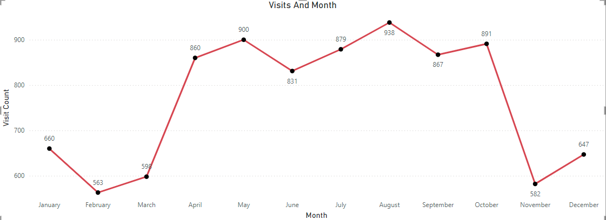
MONTHLY VISIT TRENDS
We can see that August was the month with the most visit and December was the month with the least.
We can observer that there is a high volume of patients all through April to October and then a sharp decline in November.
Start of the year (January – March) and end of year (November – December) has low volume of patients.

Slide 11
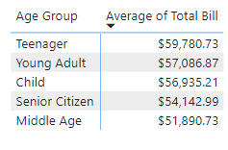
AVERAGE SPENDING BY AGE GROUP
The approach I would take when it comes to providing discounts is age group.
We can provide discounts to age groups who spent the most at the hospital.
We can see that Teenagers (Aged between 12 to 20) are the ones who spent the highest on average in the hospital.
Amounting to over $59,780.73 on average, they are hospital’s biggest customer.
Secondly, if we attract more patients from the teenager age group, we might be able to create relationships with them and make a life long customers out of them.
For all the above reasons I think the hospital should give patients discounts on the basis of their age and more specifically to the teenagers.

Slide 12
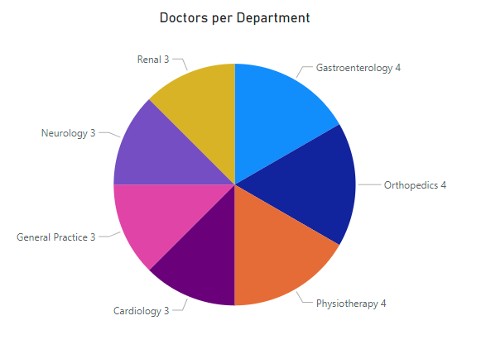
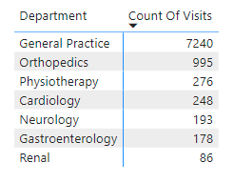
DOCTORS AND VISITS PER DEPARTMENT
The pie chart shows us different departments and the count of doctors currently working in them.
We can see that General Practices gets the highest amount of visits with 7,240.
Even Orthopedics which comes in at 2nd place with 995 visits is no where near that.
My suggestion would be to hire all 3 new doctors to the General Practice department as it has only 3 doctors currently.

Slide 13
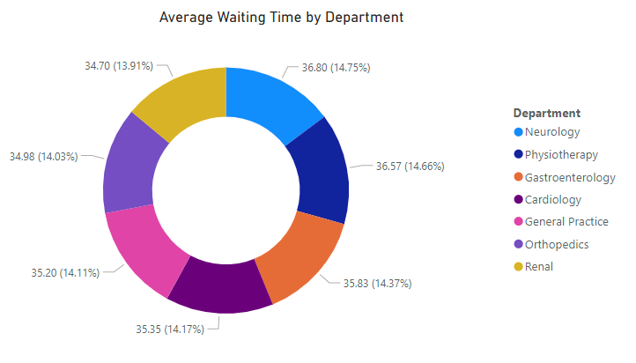
AVERAGE WAITING TIME PER DEPARTMENT
We can see that all departments almost have average waiting time in the same ball park.
All the departments have the average wait time between 34.70 minutes to 35.83 minutes which is approximately a ~1.5% of difference between the maximum and minimum.
This difference is very insignificant and hence we can conclude that there is no particular department with relatively very high wait time.

Slide 14
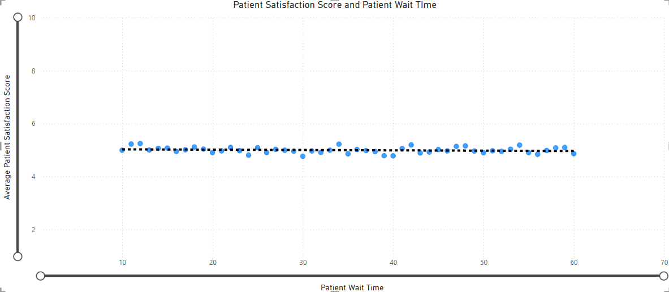
SATISFACTION SCORE AND WAITING TIME
We can observe from the above scatter plot that there is a negative correlation between patient satisfaction score and patient wait time.
The more the wait time is increase the lower the satisfaction score gets.
Even though there are a few outliers in the dataset, but we can still conclusively say that as the wait time increases, satisfaction score decreases.

Slide 15
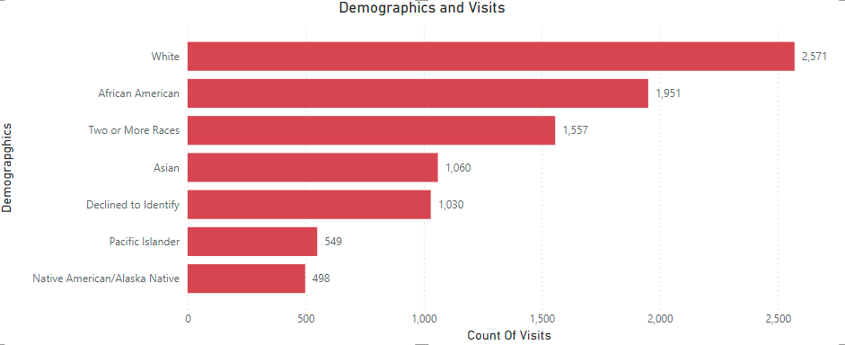
PATIENT DEMOGRAPHICS
We can see that the people identifying themselves as White visits the hospital most with 2,571 visits
Followed by African American patients with 1,951 visits
Interestingly, 1,030 patients refused to identify their race meanwhile 1,557 were of mixed heritage.
Native American/Alaskan Native have the lowest visit count of 498 visits just after Pacific Islander having 549 visits.
This could be due to relatively low population of people identifying as Native America/Alaskan Native or Pacific Islander demographic.

Slide 16
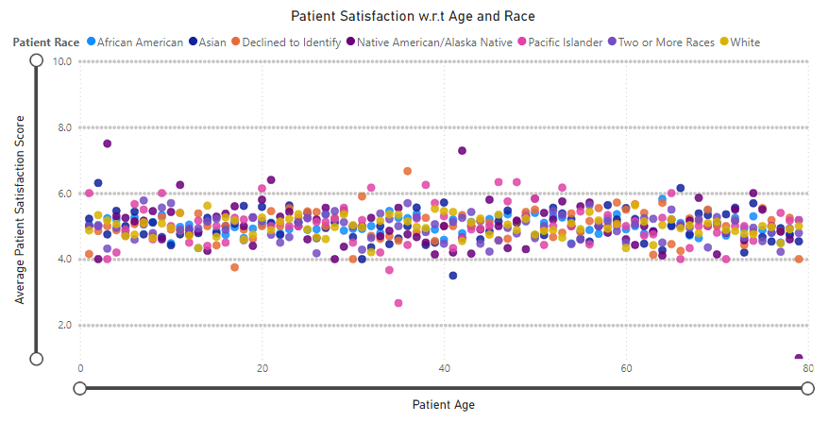
SATISFACTION SCORE, AGE AND RACE
We can observe that patients satisfaction score remains almost constantly in the range of 4.0 to 6.0 through out all the age groups
We can also see that patients with different racial backgrounds all fall in this range irrespective of their age.
We can conclude that there is no change in satisfaction score with the change of age and racial background.

Slide 17
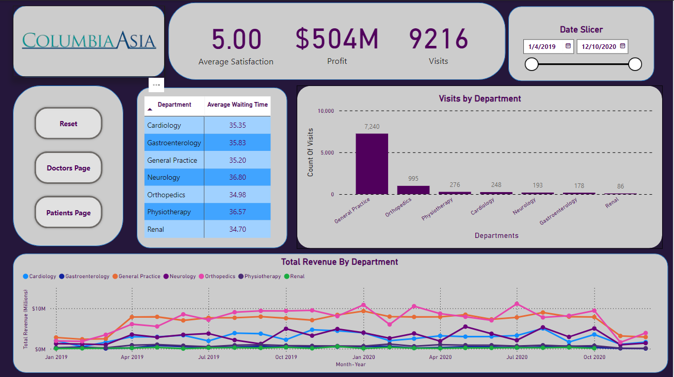

Slide 18
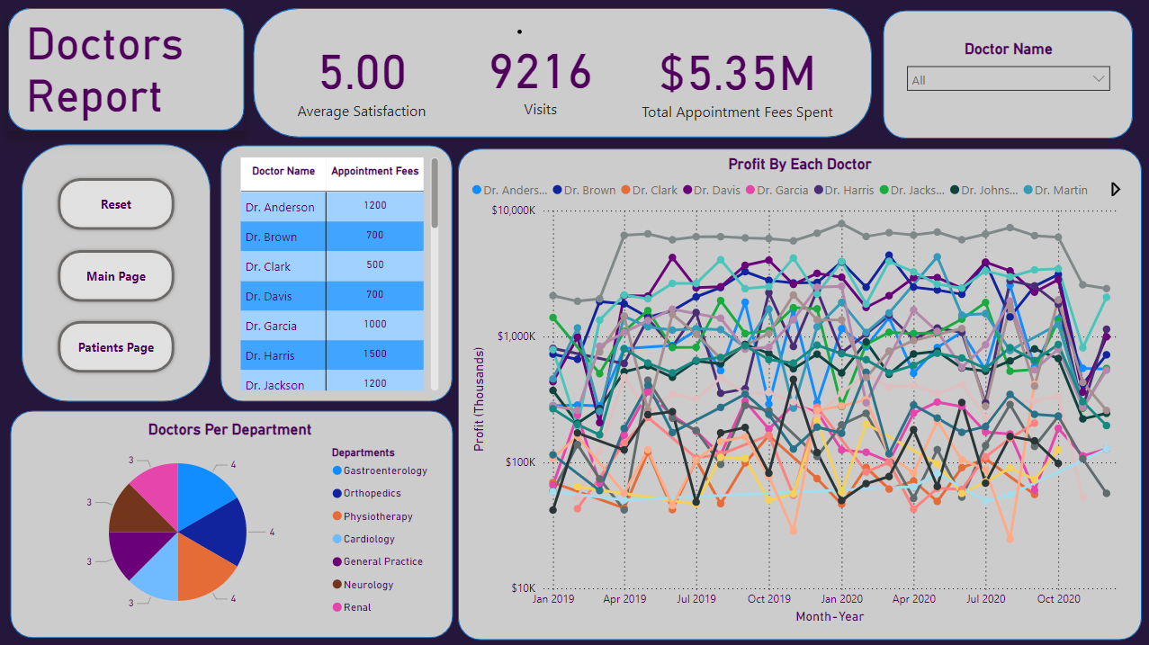

Slide 19
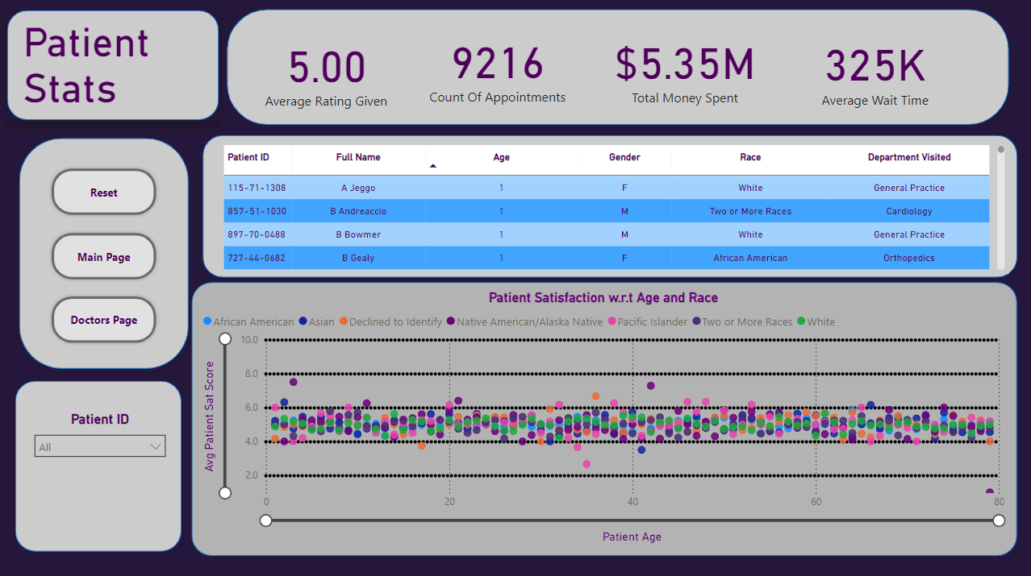

Slide 20

RECOMMENDATIONS & CONCLUSION
Hospital revenue is in the positive and we can see that it is profitable and we can see it have generated $503.96 Million of profit.
Orthopedics is our highest revenue generating department with about $172,939,773 total revenue generated.
We can observe that General Practice department has the most amount of patient visits.
The number of Doctors in the General Practice department is 3, the recommendation would be to hire 3 more doctors for the same department as it is the busiest department of the hospital.
Our datasets points to the fact that teenagers (Aged between 12 to 20) are our biggest customer base with revenue amount averaging to about $59,708.
According to our strategy, we should focus on giving discounts to the patients which are our largest customers i.e. the teenage patients group.

Slide 21

THANK YOU
References:
Newton School Columbia Asia Hospital Dataset

